Slide 1
What's new in .NET MAUI for Desktop App Development

Slide 2
What’s the latest version.
Context Menus
Foldable (*. AndroidX.Window)
Window Positioning
Tool Tips
Accessibility Validation
PointerGestureRecognizer
TapGestureRecognizer
TapEventArgs
Secondary Mask

Slide 3
What's new in .NET MAUI for Desktop App Development
Context Menus
Foldable (*. AndroidX.Window)
Window Positioning
Tool Tips
Accessibility Validation
PointerGestureRecognizer
TapGestureRecognizer
TapEventArgs
Secondary Mask

Slide 4
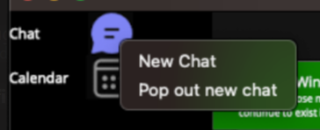
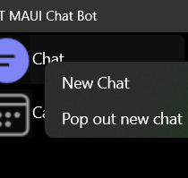
Context Menus
Are attached to a single element and display secondary commands.
Are invoked by right clicking (or an equivalent action, such as pressing and holding with your finger).
Are associated with an element via its ContextFlyout property.

Slide 5
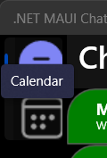
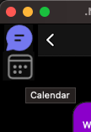
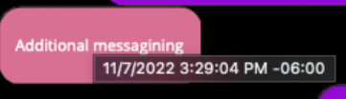
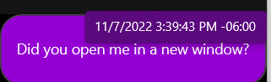
Tool Tips
A tooltip is a popup that contains additional information about another control or object.
Tooltips display automatically when the user moves focus to, presses and holds, or hovers the pointer over the associated control.
The tooltip disappears when the user moves focus from, stops pressing on, or stops hovering the pointer over the associated control (unless the pointer is moving towards the tooltip).

Slide 6
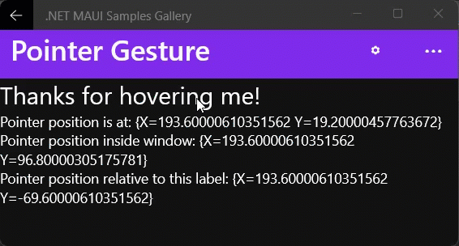
Pointer Gesture Recognizer
PointerEntered
PointerExited
PointerMoved
Pointer Position Data
Window Relative
View Relative

Slide 7
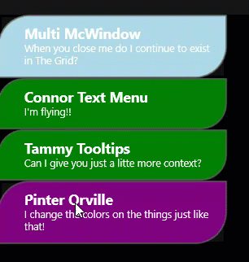
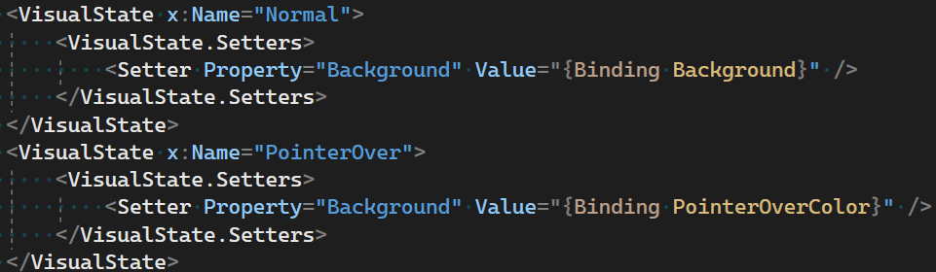
PointerOver VisualState

Slide 8
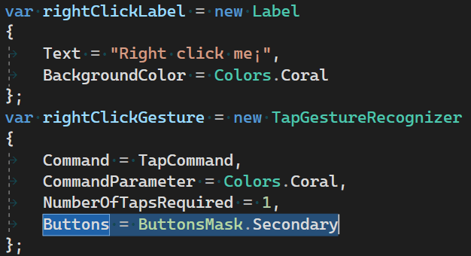
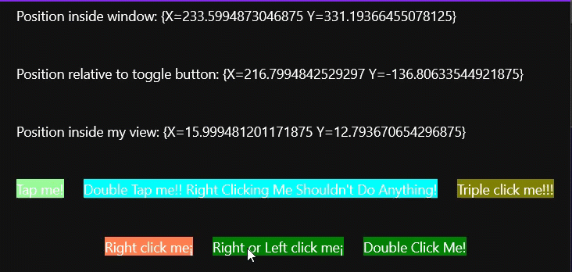
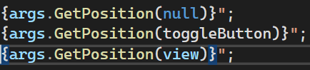
Tap Gesture Recognizer Improvements
Buttons Mask
TappedEventArgs

Slide 9
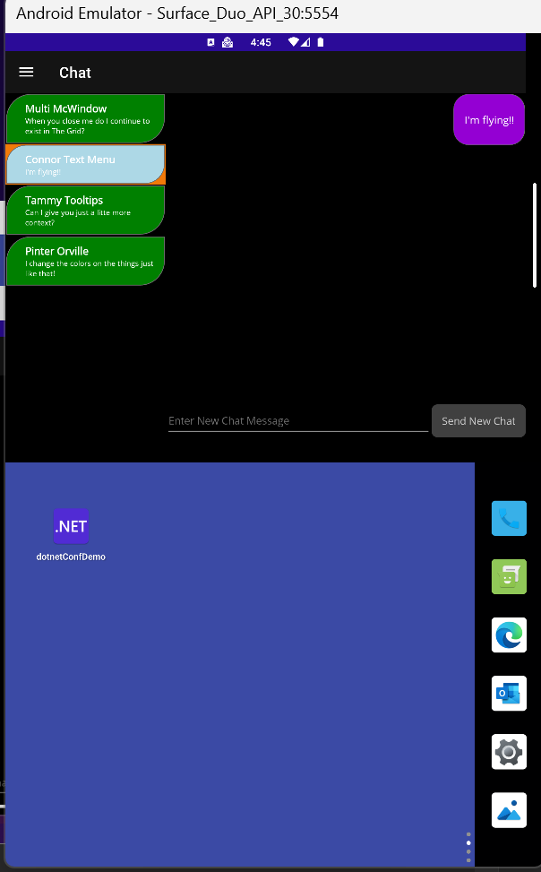
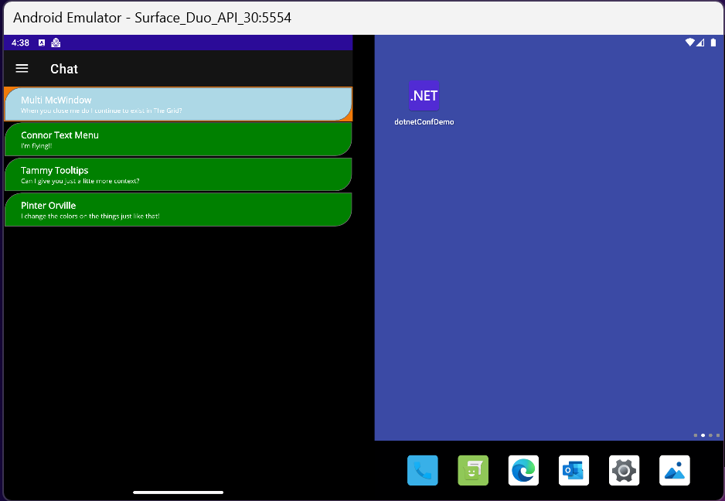
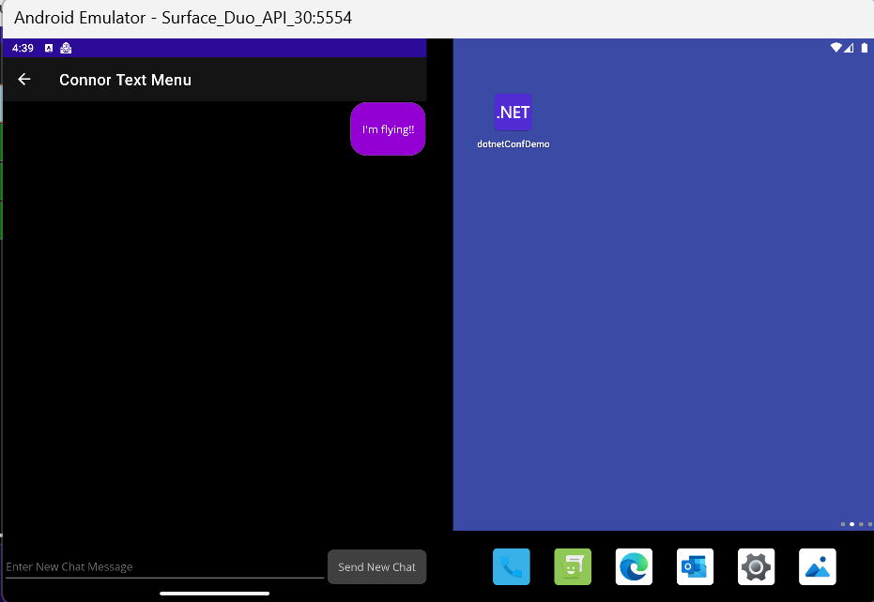
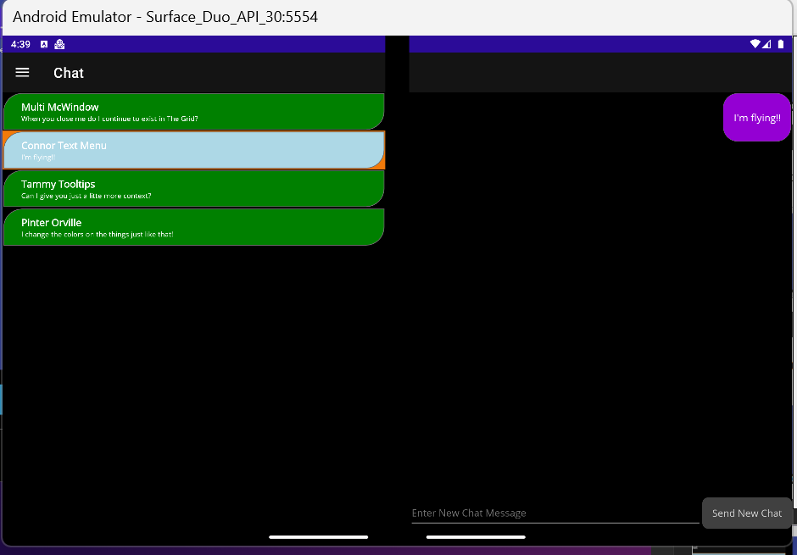
Foldable Support

Slide 10
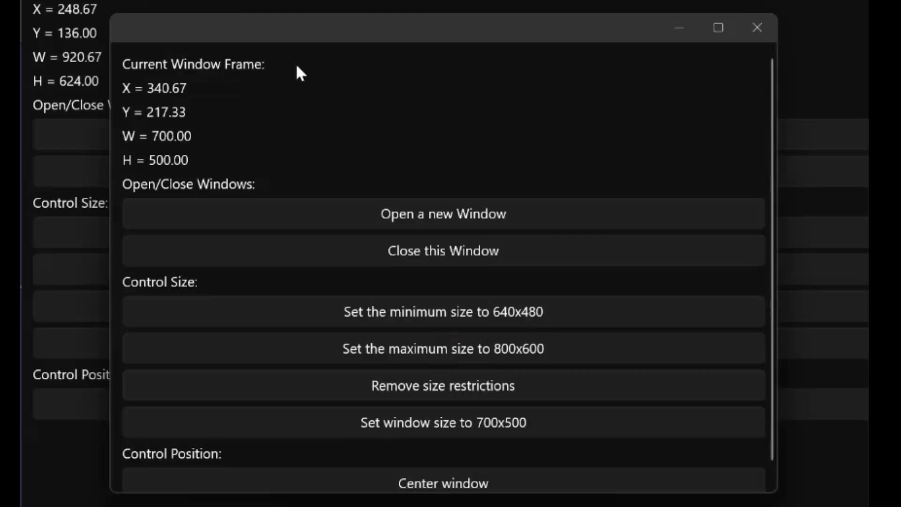
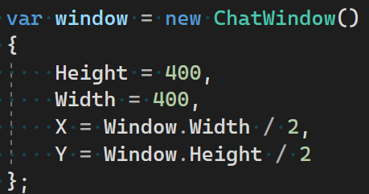
Window Position/Location APIs

Slide 11
Additional Desktop and Multi-Window
Accessibility Validation
MenuBar
ScopedServices

Slide 12
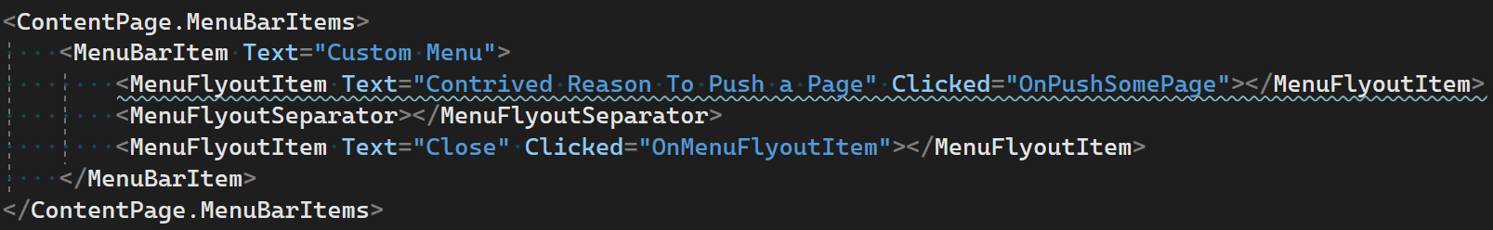
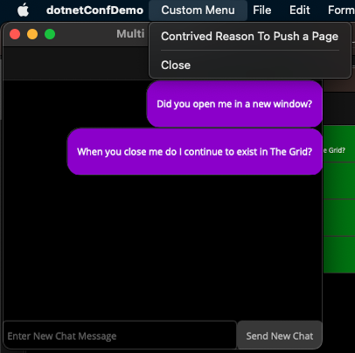
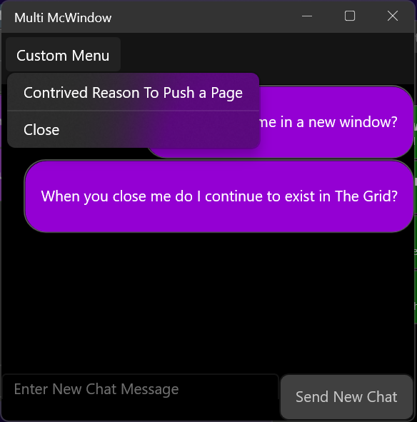
MenuBar

Slide 13
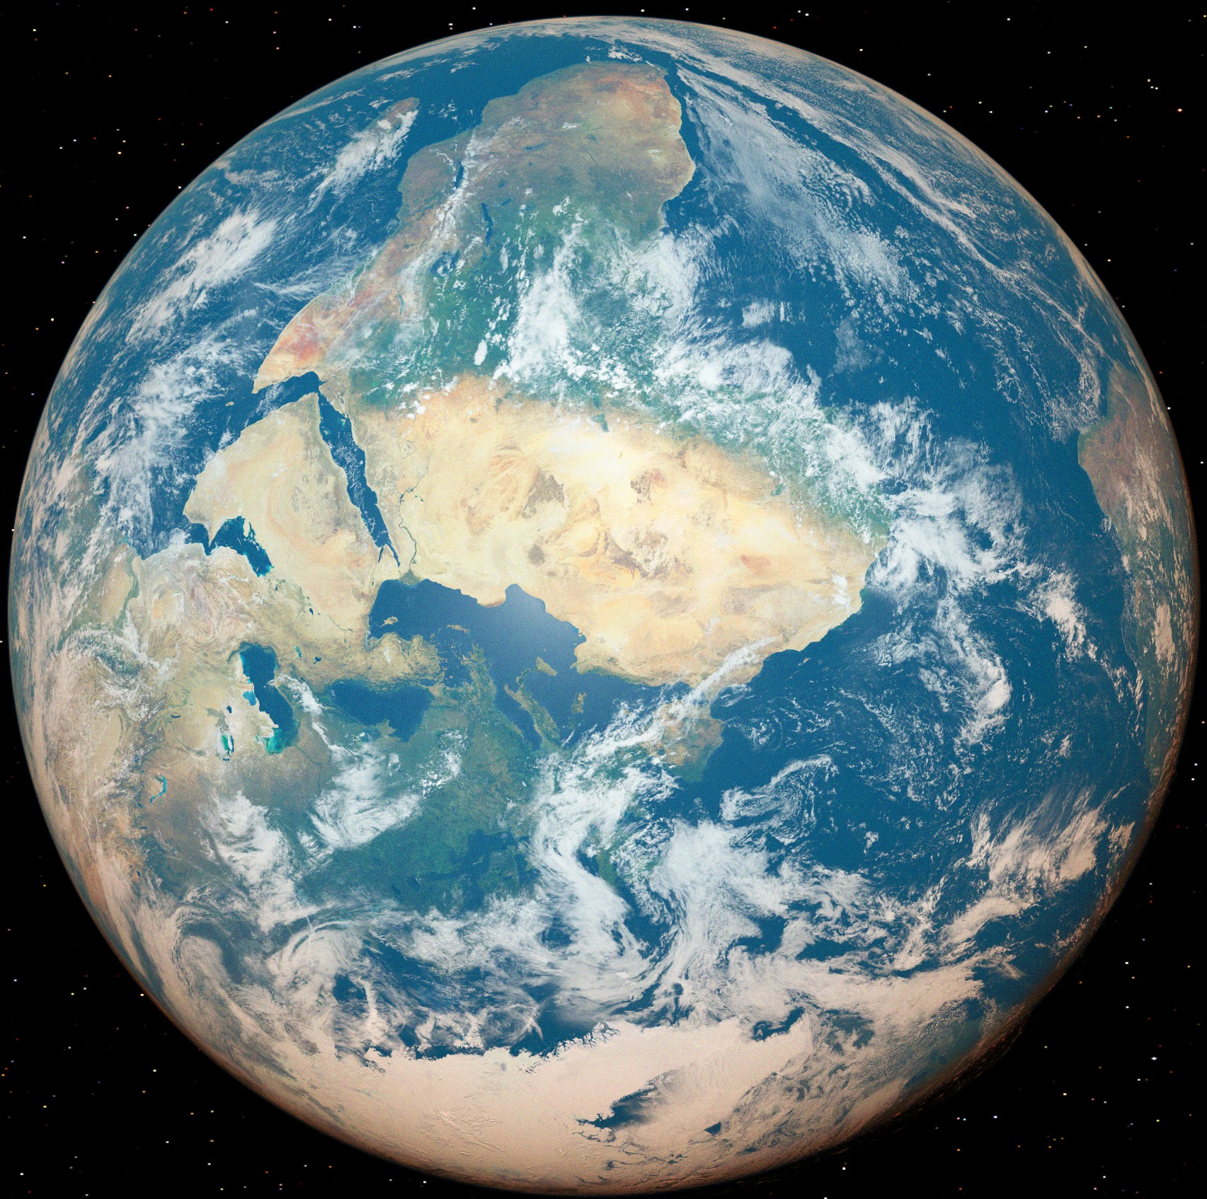


Scoped Services with MS.EXT.DI
AddSingleton
Registers at the app level
AddScoped
Registers per Window
AddTransient
Single Use Types

Slide 14
Accessibility Notes
Closed at least 35 accessibility bugs in the last period.

Slide 15
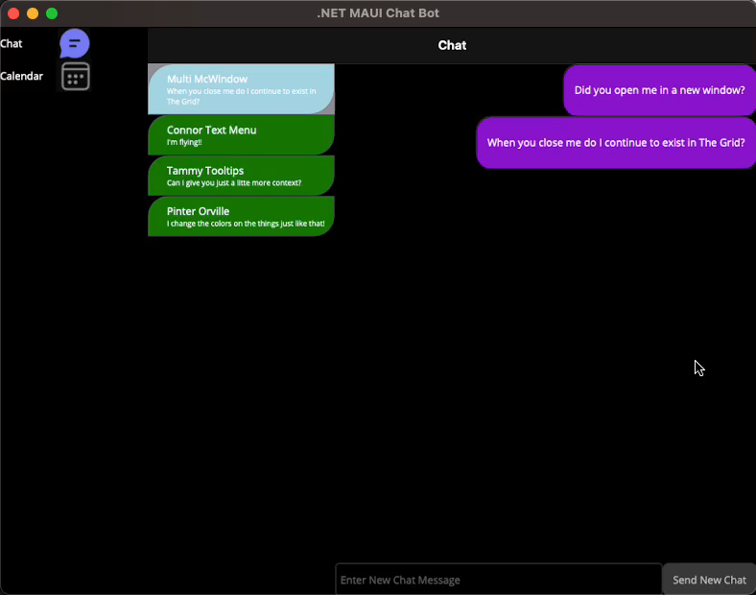
Catalyst Demo

Slide 16
Here’s where you get it, getting in touch, file a github issues for things at the end
Talk up Visual Studio for Mac is now GA with 17.4 so go get it
Other Samples possibly
Podcast
Weather Twenty whatever
See if Javier has a screen shot

